Slide 1
Week 4
Computer Vision

Slide 2
What we have learnt in this week’s videos?
Object detection with region proposal
Object detection with Yolo and SSD

Slide 3
Session Agenda
Object localization, detection
Object detection with region proposal
Object detection with Yolo and SSD
Intersection over union
Case study
Questions

Slide 4
Object detection

Slide 5
What are localization and detection?

Slide 6
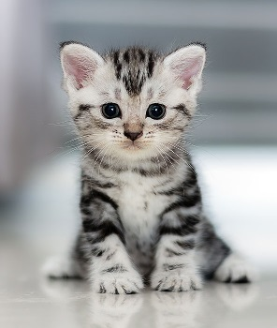
Image classification
Classify an image to a specific class. The whole image represents one class. We don't want to know exactly where are the object. Usually only one object is presented.

Slide 7
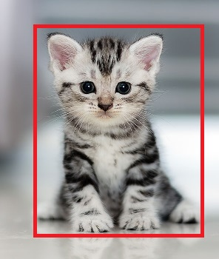
Classification with localization
Given an image we want to learn the class of the image and where are the class location in the image. We need to detect a class and a rectangle of where that object is. Usually only one object is presented.

Slide 8
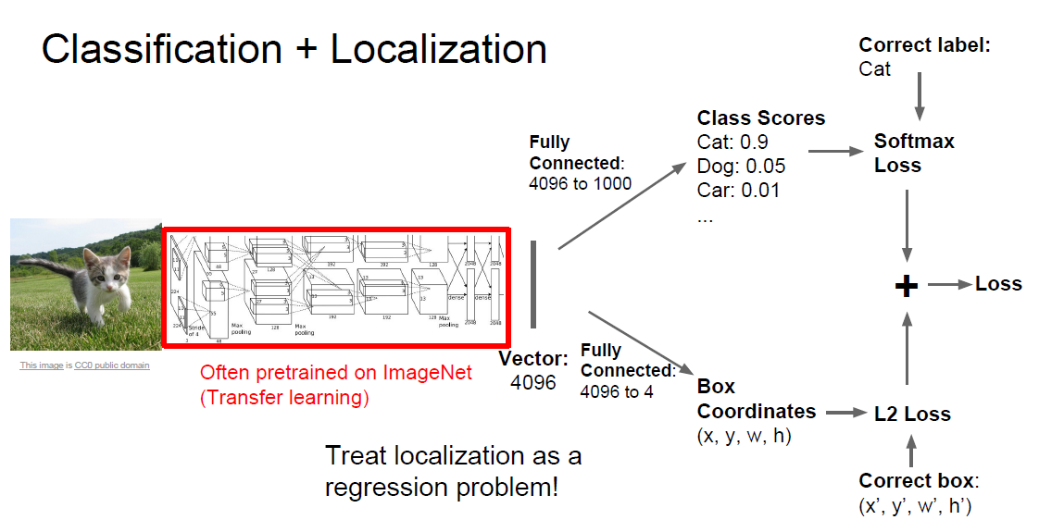
Classification + localization
Multitask Loss

Slide 9
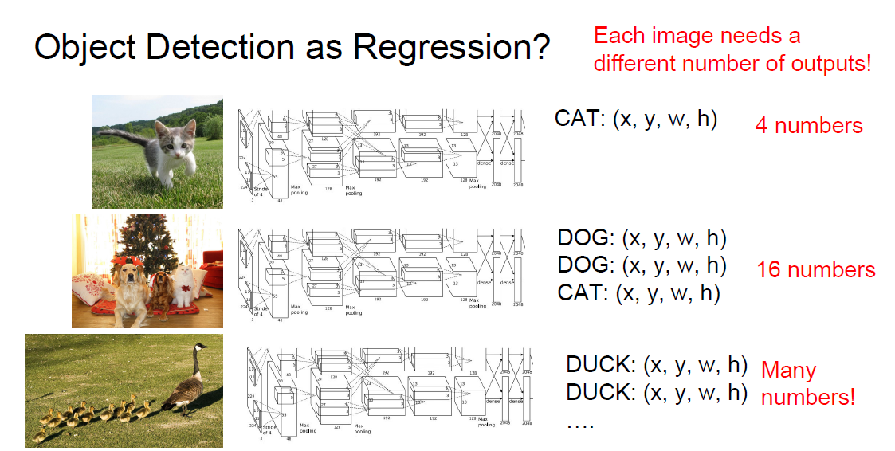
Object detection as regression

Slide 10
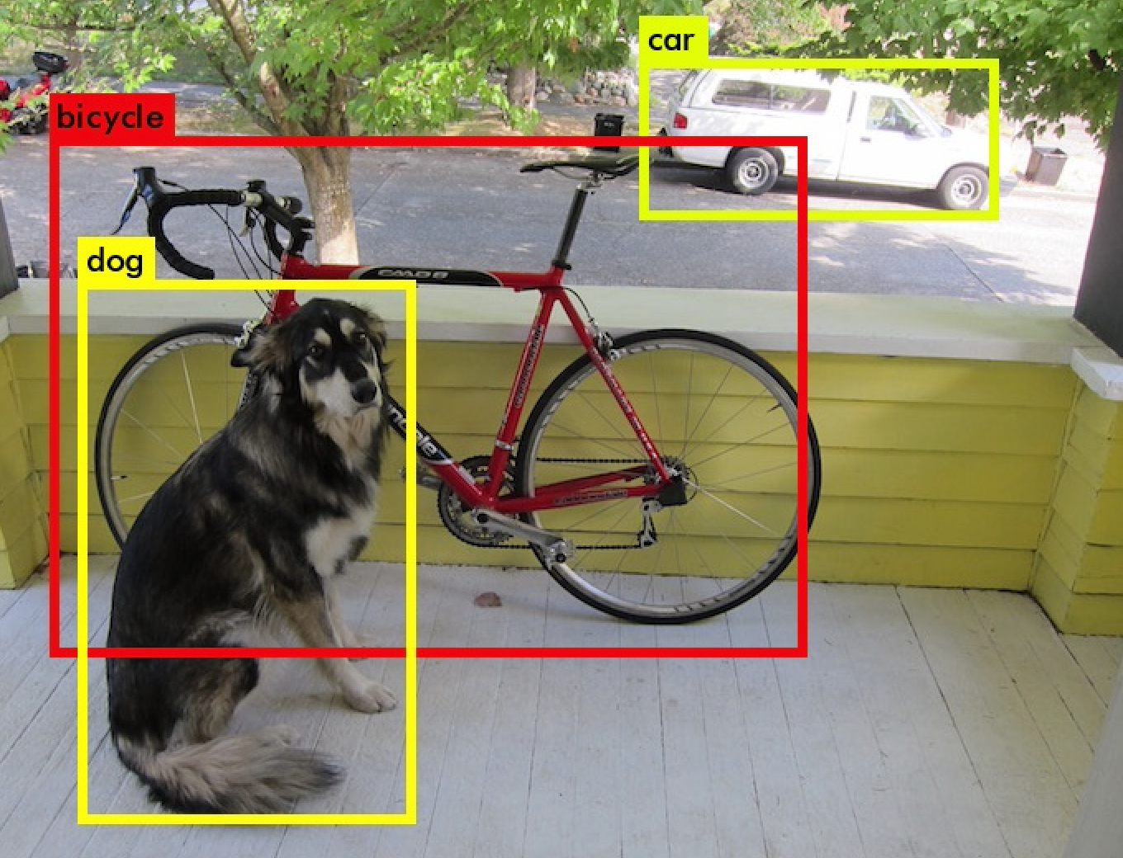
Object detection
Given an image we want to detect all the object in the image that belong to a specific classes and give their location. An image can contain more than one object with different classes.

Slide 11
Some points
To make image classification we use a ConvNet with a Softmax attached to the end of it.
To make classification with localization we use a ConvNet with a softmax attached to the end of it and a four numbers bx, by, bh, and bw to tell you the location of the class in the image. The dataset should contain this four numbers with the class too.

Slide 12
Region proposal

Slide 13
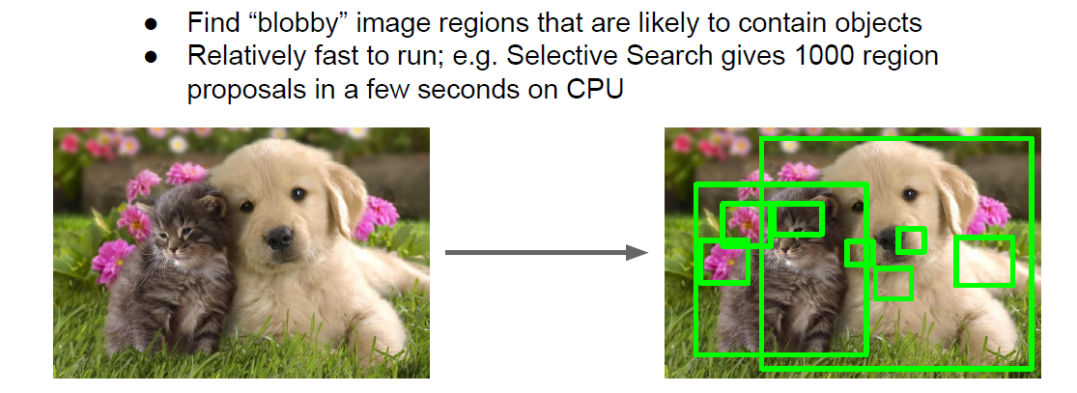
Region Proposal

Slide 14
Region Proposals (R-CNN)
R-CNN is an algorithm that also makes an object detection.
One of the downsides of YOLO is that it process a lot of areas where no objects are present.
R-CNN stands for regions with Conv Nets.
R-CNN tries to pick a few windows and run a Conv net (your confident classifier) on top of them.

Slide 15
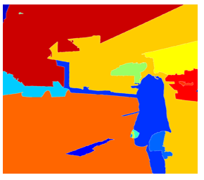
Region Proposals (R-CNN)
The algorithm R-CNN uses to pick windows is called a segmentation algorithm.

Slide 16
Region Proposals (R-CNN)
Most of the implementation of faster R-CNN are still slower than YOLO.
Andrew Ng thinks that the idea behind YOLO is better than R-CNN because you are able to do all the things in just one time instead of two times.
Other algorithms that uses one shot to get the output includes SSD and MultiBox.
R-FCN is similar to Faster R-CNN but more efficient.

Slide 17
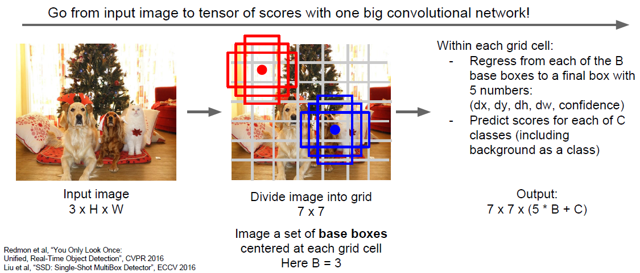
Detection without proposals: YOLO/SSD

Slide 18
YOLO

Slide 19
YOLO
YOLO – You only look once, looks at the image just once but in a clever way “We reframe the object detection as a single regression problem, straight from image pixels to bounding box coordinates and class probabilities”
Algorithmic flow :
Actually Divides the image into a grid of say, 13*13 cells (S=13)
Each of these cells is responsible for predicting 5 bounding boxes (B=5) (A bounding box describes the rectangle that encloses an object)
YOLO for each bounding box
outputs a confidence score that tells us how good is the shape of the box
the cell also predicts a class
The confidence score of bounding box and class prediction are combined into final score -> probability that this bounding box contains a specific object

Slide 20
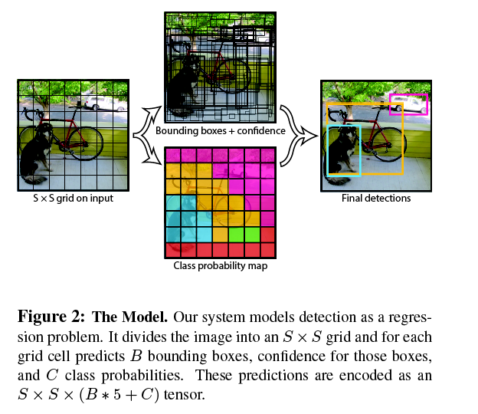
YOLO

Slide 21
YOLO
13*13 = 169 grid cells
Each cell predicts 5 bounding boxes
169*5 = 845 bounding boxes
Most of the boxes have low confidence score
Threshold of 30% or more -> 3
Input image: 416*416 pixels resized
13*13*125 tensor describing the bounding boxes for grid cells
YoLO v2 vs v1 – faster version

Slide 22
Single-shot detection

Slide 23
Single-shot detection
By using SSD, we only need to take one single shot to detect multiple objects within the image
Regional proposal network (RPN) based approaches such as R-CNN, Fast R-CNN series need two shots, one for generating region proposals, one for detecting the object of each proposal.
SSD is much faster compared with two-shot RPN-based approaches.
The loss function consists of two terms: Lconf (confidence loss) and Lloc (localization loss)

Slide 24
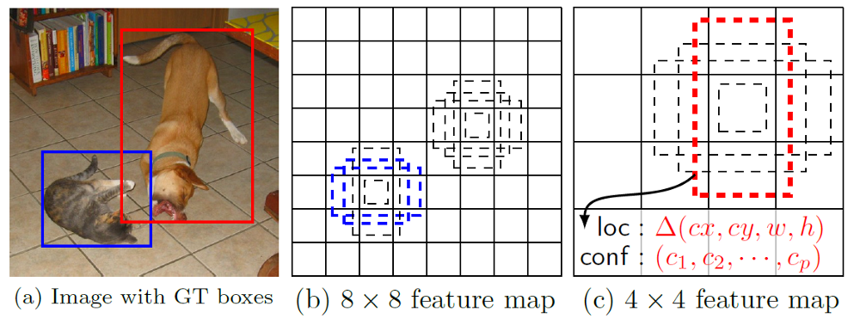
Single-shot detection
A feature layer of size m×n (number of locations) with p channels
For each location, we got k bounding boxes
For each of the bounding box, we will compute c class scores and 4 offsets relative to the original default bounding box shape.
Thus, we got (c+4) kmn outputs.

Slide 25
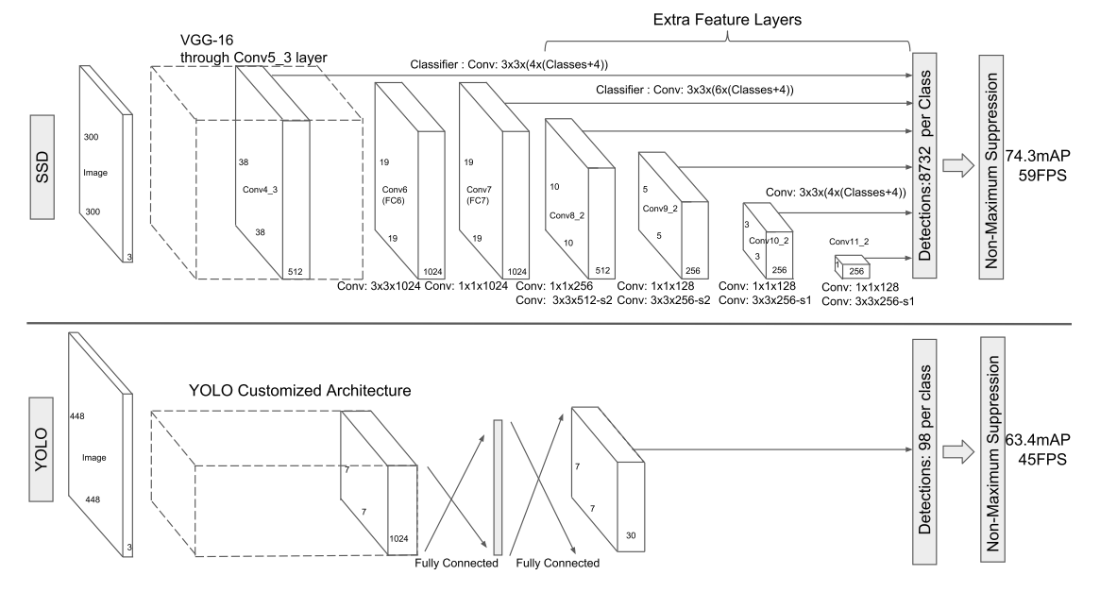
SSD and YOLO

Slide 26
Intersection over union

Slide 27
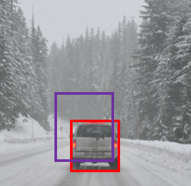
Intersection over union
Intersection Over Union is a function used to evaluate the object detection algorithm.
It computes size of intersection and divide it by the union. More generally, IoU is a measure of the overlap between two bounding boxes.
For example:
The red is the labeled output and the purple is the predicted output.
To compute Intersection Over Union we first compute the union area of the two rectangles which is "the first rectangle + second rectangle" Then compute the intersection area between these two rectangles.
Finally IOU = intersection area / Union area
If IOU >=0.5 then its good. The best answer will be 1.
The higher the IOU the better is the accuracy.

Slide 28


AIML @WORK
PGPAIML @ Great Learning
Enabling Learners to Apply the AI/ML Concepts at Work
Apply AIML at your workplace to gain some instant benefits:
Get noticed by your management with your outstanding analysis backed by data science.
Create an impact in your organization by taking up small projects/initiatives to solve critical issues using data science.
Network with members from the data science vertical of your organization and seek opportunities to contribute in small projects.
Share your success stories with us and the world to position yourself as a subject matter expert in data science.
AIML Operations | AIMLAW
@Great Learning Proprietary Content. All rights reserved. Unauthorized use or distribution prohibited

